Slide 1
When is a Project Ready for Software Automation?
Michael Christesen
Mat Krueper
Ty Henson

Slide 2
Introduction
Michael Christesen
Mat Krueper
Ty Henson

Slide 3
Agenda
Mike:
Automation Misconceptions
Quick Review of Manual vs Automation Concepts
Methodology and Automation
Tips for Successful Automation
An alternative way to measure the cost of Automation
Mat:
Tips on selecting the right Automation tools
Key Performance Indicators for Automation
Return on Investment
Review of real-world gains through Automation

Slide 4
For Every Project
Notes:
Ask Audience…
Top 3 happen frequent and are not major impacts (but can be).
Bottom half happen less frequently, but when they do are typically major impacts!

Slide 5
The Basics: Benefits of Manual Testing
Low Cost (Short term)
Effective at Finding Real User Issues
Flexible
Graphic from leaseweblabs.com
Notes:
Point 3: How many times have you needed to update a step in a test case? In manual testing, this is easy – but in automation scripts, it may be a little more involved.

Slide 6
The Basics: Difficulties of Manual Testing
(Some) Tests are Difficult to Run
(Some) Tests are Repetitive and Boring
Subject to Human Error
Repetitive – Each Test is Run by Hand

Slide 7
The Basics: Difficulties of Automation
Can be Expensive
Initially Time Intensive
Automated Tools have Limitations
Defect investigation can take longer
Graphic from http://blog.valuelabs.com/
Notes:
Automation will test only what the tester define – nothing more.
Additionally, People notice things that Automation ignores – layout issues within a screen, differences between screens, or odd behavior is often filtered out by automation.
Question: For all the time spent building automated scripts, how many bugs would you have found if you were manually testing during that time? What would be their severity?

Slide 8
Why would you Automate?
Historically, it can take 3-10 times longer to automate a test cases compared to running it manually. (Over the last 5 years, some tools have decreased this to just 1.5 times!)
So you need to execute the automated test over (at least) the same number of iterations to break even.
There are also hidden costs to consider:
Licensing
Infrastructure
Support
Training
Notes:
If a Automated test is only run a few times, it is not profitable to automate!

Slide 9
The Basics: Benefits of Automation
Quick to Run
Cost Effective
Testers can focus on new features
Test results are available for all to see
Execute detailed, repetitive, data intensive tests – automatically!
Graphic from sdtimes.com
Notes:
Great for data-intensive testing!
Can test substantially more code!
Makes the most of limited resources.
How many people have encountered bugs that they swear happened, but can not reproduce them? Automtion doesn’t have this issue.

Slide 10
The Basics: Automation and Methodology
Waterfall:
Automation is a NOT a side project…it’s a full time role!
Agile
You need to automate your Regression tests since the amount of Regression continually expands with each Sprint.
If a test is only performed once...don’t automate!
Includes:
Edge Cases
Exploratory tests
Graphic from apicasystem.com
Notes:
Waterfall projects will tend not to invest in automation as a priority, primarily due to the phased investment and handoff mindset that accompanies that approach. At best, builds may leverage some automation, and a phase of a waterfall project may be dedicated to functional test automation for long-term support/future release needs, but it’s rare to find much more in a back-end-loaded waterfall project.”
In Agile, the reason that its important to automate is that the number of test cases grows continually with the new functionality added in each sprint.
Also, with Agile, it’s most common for there to be a combination of white-box (under-the-covers) and UI automation (black-box) tests. The white-box tests tend to be less fragile, so are less costly to maintain, whereas the black-box UI-driven tests need to be leveraged judiciously due to the cost to develop and maintain the tests over time. Ideally, testers are involved in both, so that the black-box tests can supplement instead of duplicating white-box tests.”

Slide 11
The Cost of Automation
Common Measurement: Most companies determine the cost of automation as the time (in hours) spent doing automation.
Alternative Measurement: Number of Bugs forgone...
Reason: The point of automation is to find more bugs running scripts. Bugs found are the value of automation. Maybe automation should be measured the same way?
Graphic from Santexgroup.com
Notes:
What is the cost of automation to your group? Walk through examples.

Slide 12
The Goal: Successful Automation
Suggestions:
Automate the ‘Right’ Test Cases
Test Early / Test Often
Define Quality Test Data
Design Automated Tests that can resist change
Selecting the right Automation Tool
Graphic from qatestlab.com
Notes:
As Quality Assurance professionals – we are paid to be cost effective.
For Agile: Automated tests can provide faster feedback than a manual test, reducing rework and long feedback cycles. Thus, if ROI is producing high-quality software iteratively, then yes, you see a nice return on your automation.

Slide 13
Automate the ‘Right’ Test Cases
Repetitively Run Tests (aka Smoke or Acceptance tests)
Data intensive tests
Frequently Used Functionality
High Risk, Business-critical functionality
Tests that are difficult to run manually
Tests that are run on differing hardware/software platforms and configurations
Tests that take a lot of effort or time
Graphic from qatestlab.com
Notes:
You can not automate everything – your automated test suite will grow over time.
Also mention: If you find a bug, you will now have to rerun the test. This doesn’t make the case for automation. But it does identify an area of code that will have future changes (more bugs) and may be a candidate for future automation.
Automate these first, then seek other tests to automate!

Slide 14
Test Early / Test Often
Start as early in the process as possible
Could start with Automated Unit testing
Gradually build your Automation Suite
The more you test, the more bugs you find.
The earlier bugs are found the cheaper they are to fix!

Slide 15
Define Quality Test Data
With good data…
Writing and Maintaining Automated tests is easier.
With Data driven tests you can run more iterations and find more bugs!
Can extend existing Automated tests as new features are developed – without having to edit the actual automated test itself.
Stay proactive in updating/defining data.
Notes:
40% of your test time will be spent finding good test data.
Give (Caremark) Mail Order Pharmacy as an example.

Slide 16
Automation Approach
Keep Automated tests small and focused
Easy to debug
Easy to manage
Can be reused and shared
These can then be grouped into a larger Automated test suite organized by functional area.
With the right framework, users can create large/complex Automated tests that are also easy to maintain!
Graphic from checkpointech.com

Slide 17
Design Automated Tests Resistant to Change
If possible, avoid using screen coordinates.
Componentize your test scripts
Ensure that your development team uses unique names for each control and object!
Notes:
Pete: Any others???

Slide 18
How long do Automated Tests Last?
At some point, the application will change and the script will break.
If you are using GUI Capture/Playback a major revision to the UI may break your tests.
If the script breaks before the automation effort was repaid, it is better off as a manual test.
Notes:
Once the script is broken, it will need to be repaired or in worst cases it will be thrown away and re-written.

Slide 19
Selecting the ‘‘Right” Automation Tool
Simple
Fast
Can be used by business users
No programming skills required
Automate 60-70% of core business processes in 90 days or less
Rapid return on investment
Resilient
Complete
When underlying applications change, automation continues to work
Simple maintenance of your
business process portfolio
True end-to-end business process validation
covering all major technologies and platforms
Functional, performance,
role-based and risk-based validation -
24/7/365 coverage

Slide 20
Choose Technology That Covers Everything
ERP
CRM
SRM
SCM
PLM
EPM (BPC)
Enterprise
Portal
SAP HANA®
SAP BusinessObjectsTM
Mobile
Adobe Flex

Slide 21
KPIs for Investments in Automation Infrastructure
Here are 5 KPIs that should be considered when evaluating the ROI of projects in automated business process validation:
Acceleration in project timelines (deployment time for new technologies)
Length of test cycles
Reduction in customer-impacting defects
Hours of reduction in staff effort
Team throughput (number of projects delivered with the same resources)
Notes:
When it comes to automation technology, there are both soft benefits and hard benefits. When you can eliminate tedious, manual effort and allow your team to focus on higher value, enriching job experiences – that’s an important automation benefit. Increasing job satisfaction has real value, but it’s not easy to measure so we call that a soft benefit. On the other hand, there are a host of automation benefits that you can measure precisely in dollars and cents. Those are the hard benefits and to do so, you need to rely on solid key performance indicators (KPIs) to find your true ROI.
To help simplify things, I’ve created a quick list of

Slide 22
Proven
Business Benefits
Efficient discovery, deeper understanding
Optimized Business Processes
Faster innovation
Shorter Project Timelines
Reduced technology risk, fewer defects
Higher Quality Execution
Improved operational efficiency
Lower Costs

Slide 23
IDC Worksoft Customer Survey and ROI Analysis Demographics
$11.4M
Net Present Value
of Worksoft Certify®
1 Year Payback Period

Slide 24
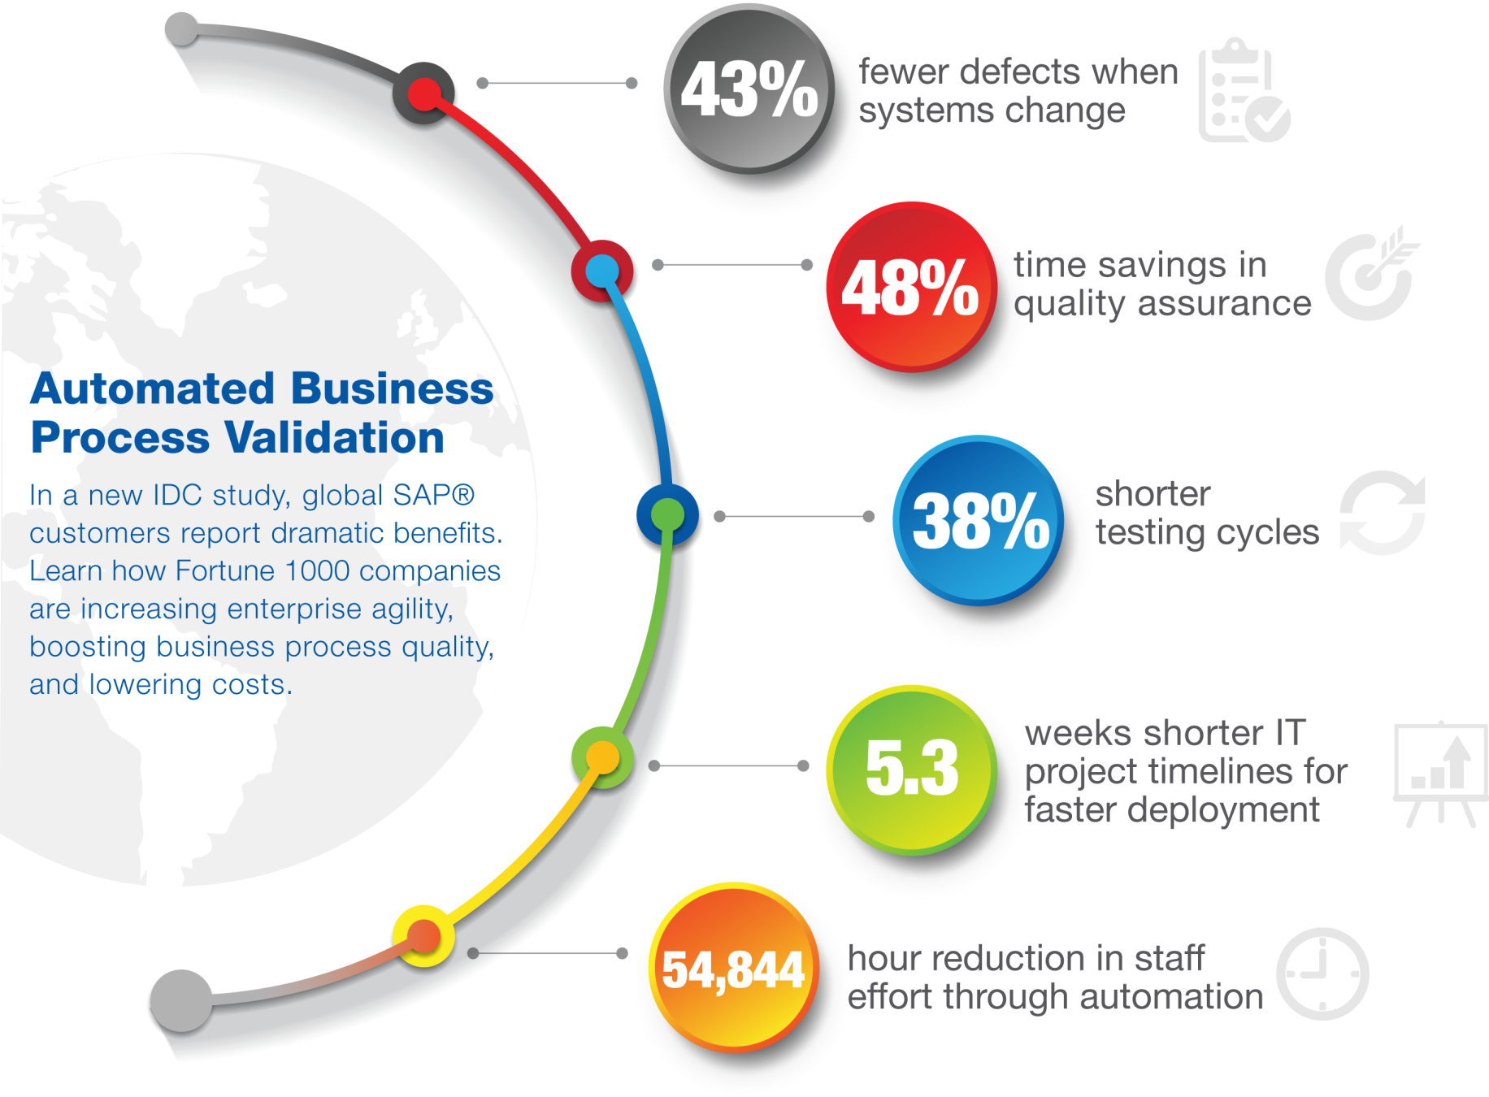
Proven
Notes:
Here’s the quantitative analysis to back it up. The industry analyst firm IDC interviewed a number of our major customers that have used automation for 3 to 5 years. These are mature, working implementations at some of the world’s largest companies. Here’s what they found:
Doing automated business process validation gets you 43% fewer defects when you make changes. Remember that it costs 4 times as much to fix a defect in production, as opposed to earlier.
50% time savings in quality assurance and testing. That’s for every single project. Take those time savings and multiply them by the dozens or hundreds of projects that your company delivers every year. It’s mind boggling what you can achieve when you adopt automation.
38% shorter testing cycles. For people who buy and use commercial applications – our customers - the largest part of the implementation project is testing because the software is already built. It just needs to be implemented, configured, and integrated. So a large part of enterprise IT projects is testing. When you cut that by 40% and shorten every project timeline, you can do more projects, you can do them faster, and you can get a competitive advantage faster by getting new technology into the hands of business users.
That’s a huge business benefit. And it changes how you do things. Let’s say you have a multi-site SAP rollout strategy. Today you have to do these rollouts sequentially – one country, then another, then another. Why? Because you only have one team to manage the rollout. But when you use automation to cut the number of people and the time needed per project, you can do more. You now have the bandwidth to do maybe 5 of these rollouts in parallel, and do more with the same team. You see, it opens up a whole new way of thinking about how to deliver projects.
The financial benefits are compelling, whether you look at the ROI, the payback, or the $11 million net present value of automation. But the total benefits are much greater than that -- when you look at the strategic benefits for the business and what it is looking to achieve.

Slide 25
Successful Automation Gains

Slide 26
Reduction in Average Hours of Effort per Organization Surveyed
54,844
Hours Saved
Annually

Slide 27
Staff for Success
Executive Sponsor
Project Owner
Project Manager
Business/ Functional Lead(s)
Automation Specialists & Testers
Automation Engineer(s)
Supporting Roles:
Note: Dashed line indicates part-time resource
Business Analyst
Database Administrator (DBA)
System Administrator / BASIS
Process Owner
Subject Matter Experts
(Business & Technical)
27
Notes:
27

Slide 28
Recap: Benefits of Automation
Time saved when execution is automatic
Enables More exhaustive testing
Manual testers can focus on new functionality
Increased confidence in the application
Notes:
Point 2: You can run the same test several times with differing data or environments.
Point 3: This is where human eyes are really needed
Point 4: Business Owners and Developers will also become more confident – where they quickly see the consequence of code change.

Slide 29
Thank you!
Learn more at CQAA.org
Questions?
Mike: Mike.Christesen@nuevista.com
Mat: mkrueper@worksoft.com
Ty: thenson@worksoft.com
Notes:
Point 2: You can run the same test several times with differing data or environments.
Point 3: This is where human eyes are really needed
Point 4: Business Owners and Developers will also become more confident – where they quickly see the consequence of code change.

